Slide 1
DATA SUFFICIENCY

Slide 2
DIRECTIONS:
A. If the data in statement I alone is sufficient to answer the question, while the data in statement II alone is not sufficient to answer the question.
B. If the data in statement II alone is sufficient to answer the question, while the data in statement I alone is not sufficient to answer the question.
C. If the data in both the statements I and II together are necessary to answer the question.
D. If the data in either I alone or II alone is sufficient to answer the question.
E. If the data in both the statements I and II together are not sufficient to answer the question.

Slide 3
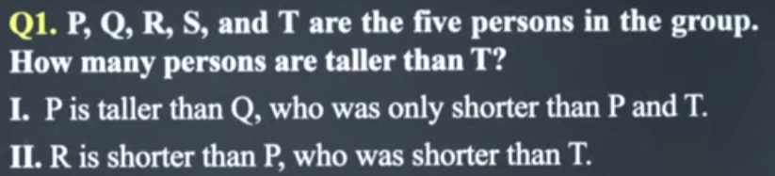
Ans: C

Slide 4
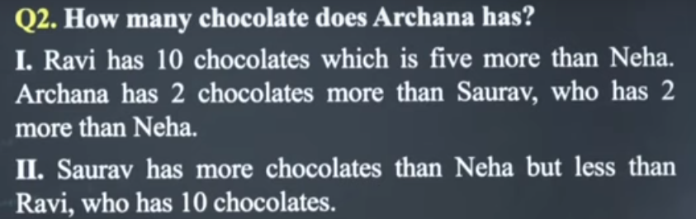
Ans: A

Slide 5
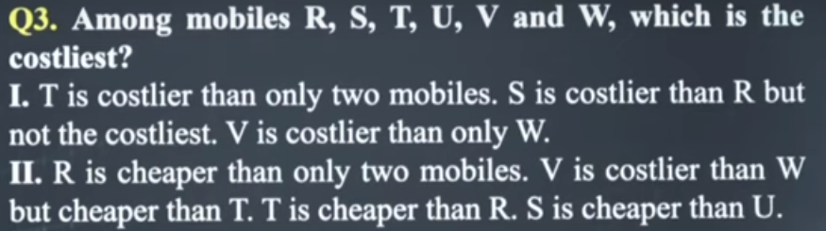
Ans: D

Slide 6
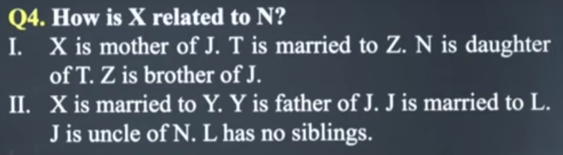
Ans: D

Slide 7
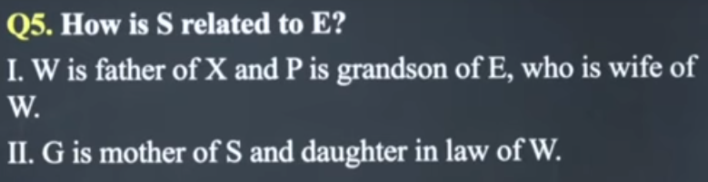
Ans: E

Slide 8
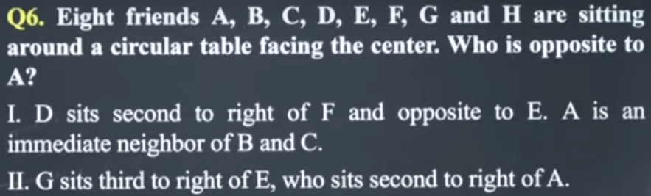
Ans: A

Slide 9
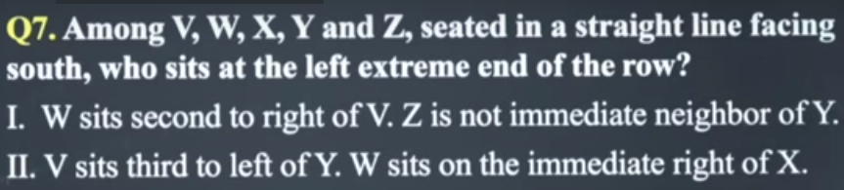
Ans: C

Slide 10
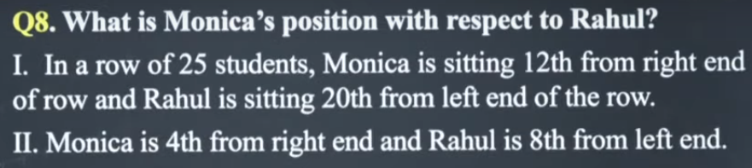
Ans: A

Slide 11
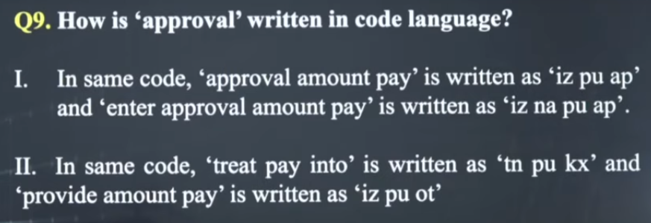
Ans: C

Slide 12
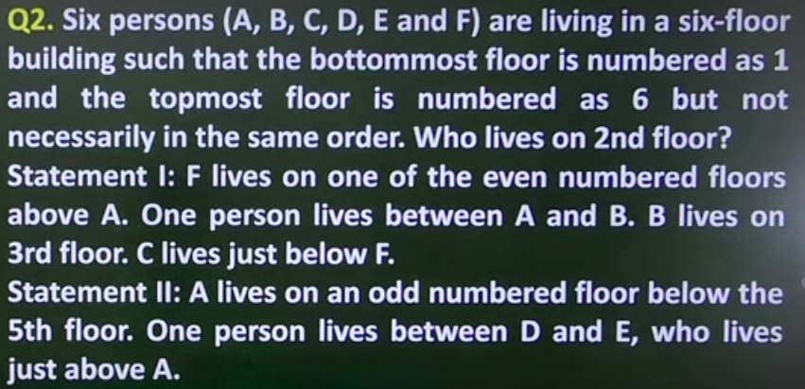
Ans: C

Slide 13
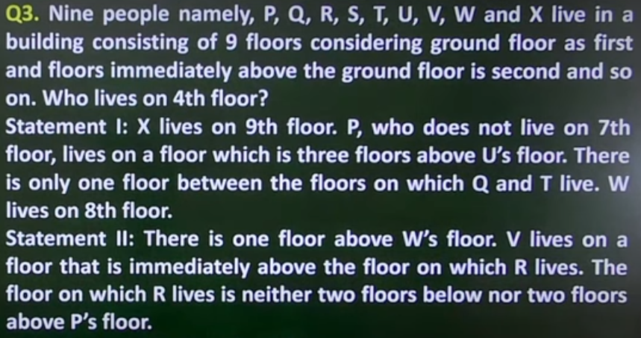
Ans: C
Ans: C

Slide 14
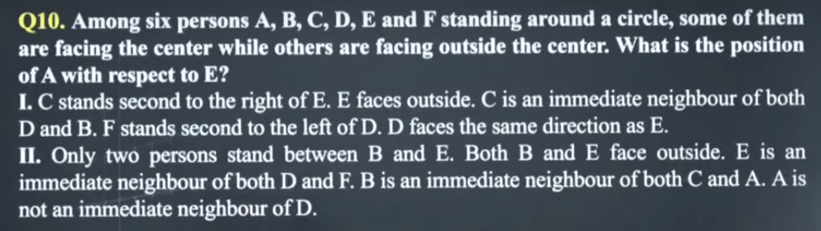

Slide 15
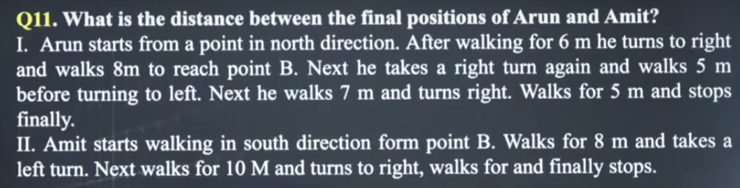

Slide 16
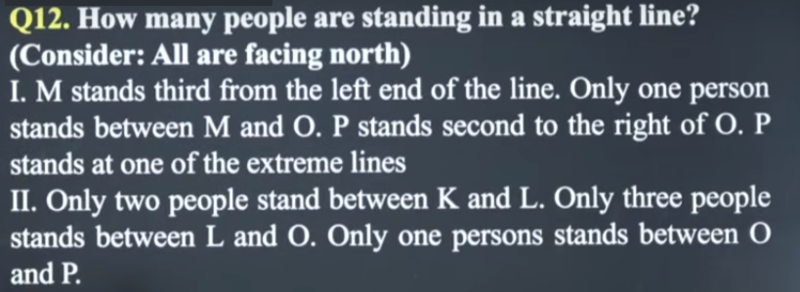

Slide 17
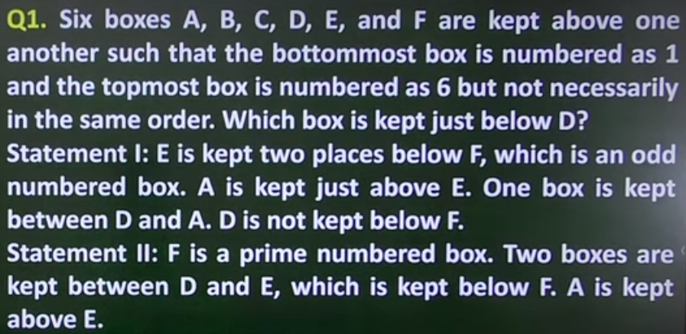
Ans:A

